Slide 1

Local Plan Consultation WDCO -
Hackney - Strategic Planning Team - 15 October 2026

Slide 2
01
Overview of Local Plan

Slide 3
Priorities for New Administration
Affordable Housing delivery
Small sites policy
Pro business
Night time economy - culture and protection of music venues
Agent of Change
Climate
Cost of carbon review
CIL charging Schedule
Engagement

Slide 4
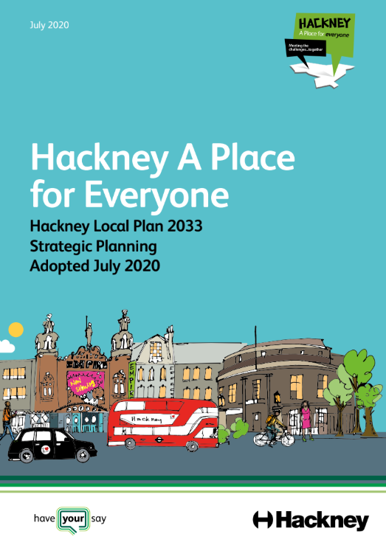
What is a local plan?
It guide how land is used and how places across the borough grow and change over the next 15 years.
Sets out policies which are used to determine whether development is acceptable.
Existing Hackney Local Plan (LP33) (July 2020)
New Local Plan 15 years 2029?
New Planning System
National Planning Policy Framework (August 2026) and draft London Plan (July 2026)
Notes:
Keung

Slide 5
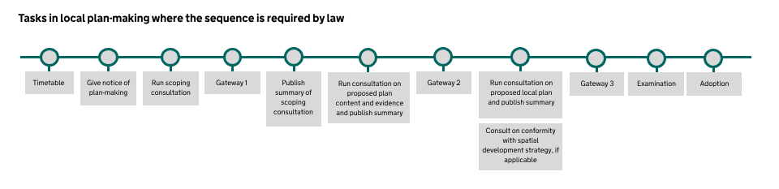
Local Plan Making Timeline

Slide 6
Key dates - Hackney’s Local Plan Timetable
Publication of Notice of Intention and Timetable | 8th July following Cabinet 29th June.
Scoping Consultation | 14 September - 2 November 2026
Publish Gateway 1 self-assessment | November 2026
Consultation on plan content and evidence base (min 6 weeks) | Summer 2027
Submission of plan for Gateway 2 | Autumn 2027
Consultation on draft plan (min 8 weeks) | Summer 2028
Submission of plan for Gateway 3 | Summer 2028
Submission of plan for Examination | Autumn 2028
Adoption | Spring 2029

Slide 7
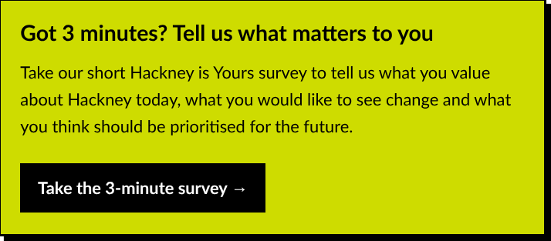
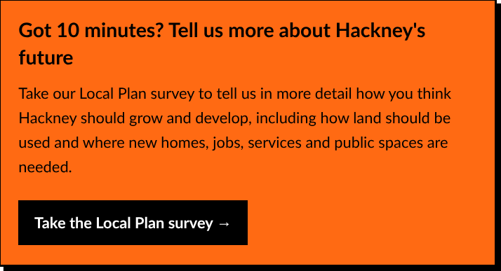
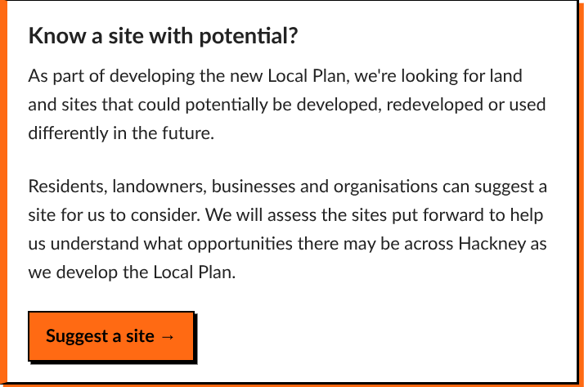
Scoping Consultation
Scoping consultation Help Shape the New Local Plan
Representations on what the plan should contain and how future engagement should be carried out
  Scoping Document - Context, Issues and Challenges
  3 Surveys
Series of drop ins
Register your interest and for updates (how you like to engaged in the future)

Slide 8
02
Getting started on new Local Plan

Slide 9
Vision, Objectives, Strategy
Locally-specific vision
Maximum of ten measurable outcomes
Area-based vs topic-based?
More strongly-defined boundaries for areas?

Slide 10
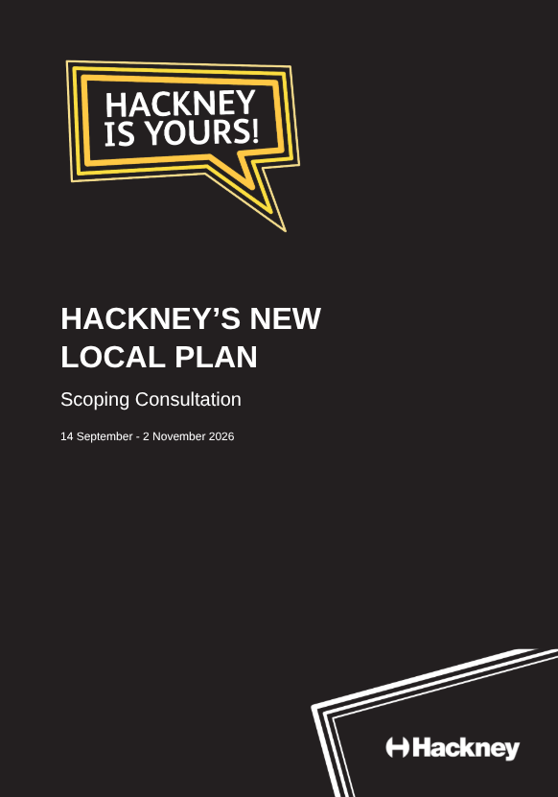
Topic Areas
Housing
Economy
Town Centres
Transport
Climate Change
Design
Open Spaces
Community Infrastructure
Emerging priorities and issues
What’s been working and what hasn’t?
Evidence base - what do we have, what do we need?
National and regional policy changes

Slide 11
Housing
Housing Delivery - LDN 55.8K PA. LBH Proposed 1,058 PA. Below the Standard Methodology calculation
Affordable Housing - threshold and tenure
Different needs and different approaches
Visitor accommodation and short-term lets

Slide 12
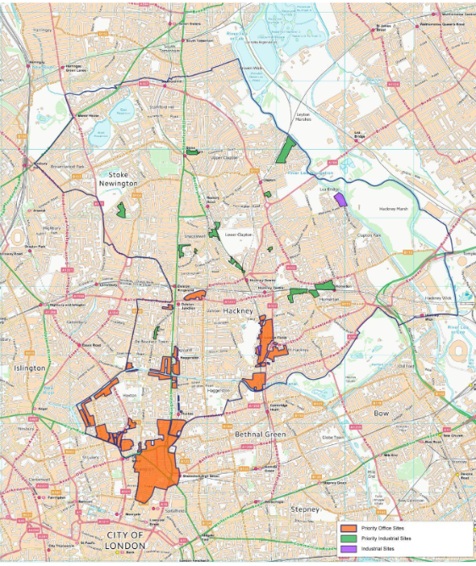
Economy and Employment
Offices in Hackney - Locations
Industrial areas - Need and Locations
Railway Arches - Future activities
Affordable Workspace

Slide 13
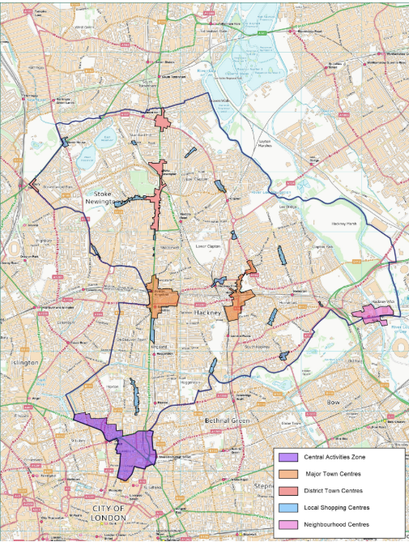
Town Centres
Difficulties for town centres - role and function
Additional flexibility, reduced control
The night-time economy
Supporting inclusive economic growth

Slide 14

Transport
Connectivity and poor public realm
Transport, safety, and health

Slide 15
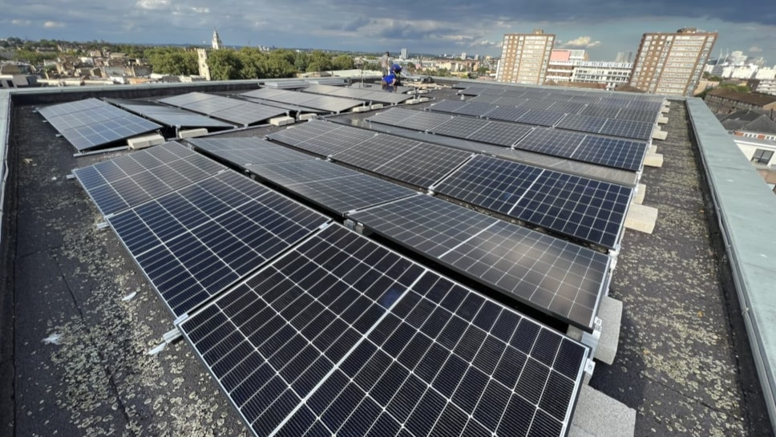
Sustainability and Climate Change
Mitigating climate change
Retrofitting and re-using existing buildings
Heat risk
Flood risk
Water efficiency
Water and air quality
Waste management

Slide 16
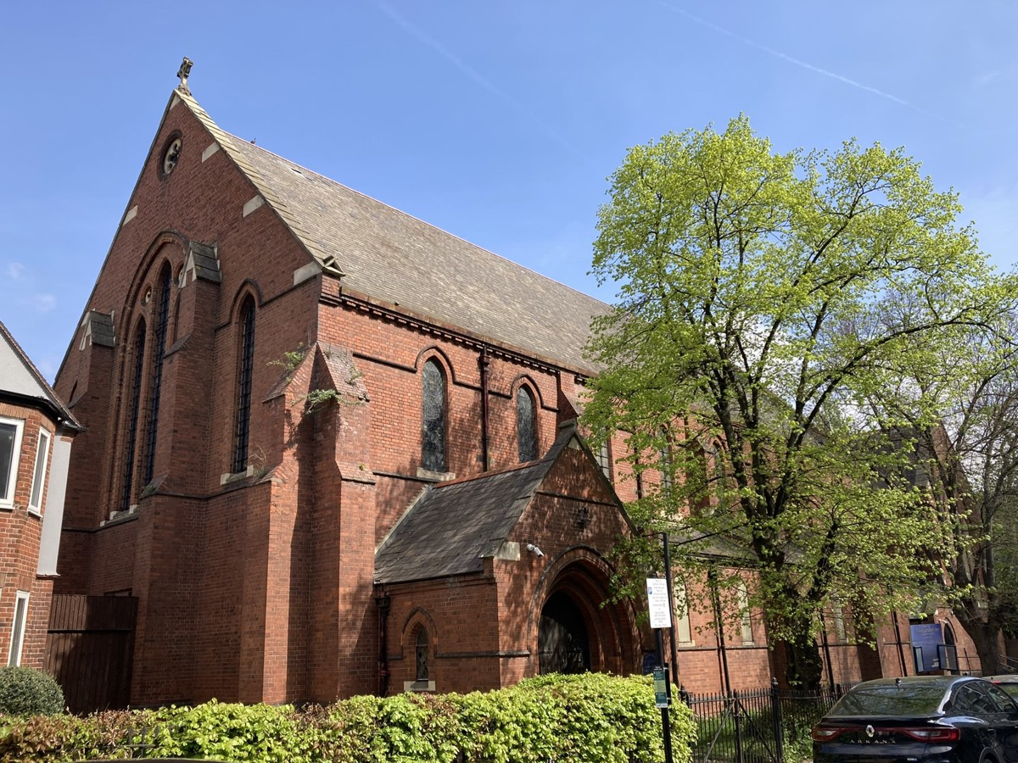
Design and Heritage
Housing Pressure
Accessibility for all
Sustainable design
Changing Areas
Community Involvement

Slide 17
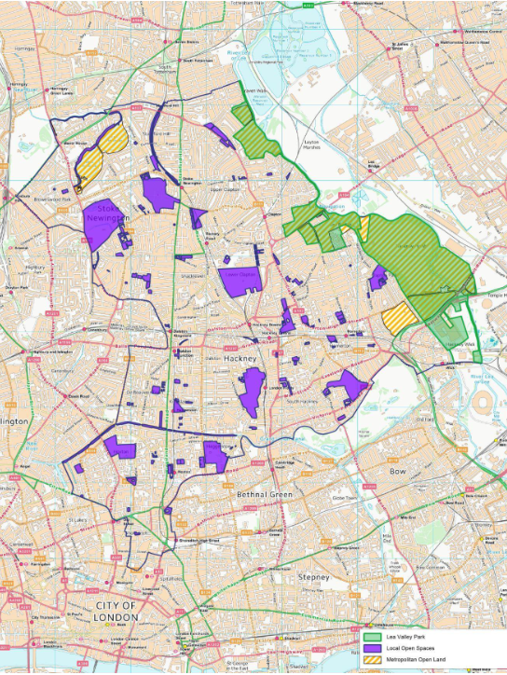
Open Spaces and Biodiversity
Limited open space
Trees
Biodiversity
Child friendly spaces

Slide 18
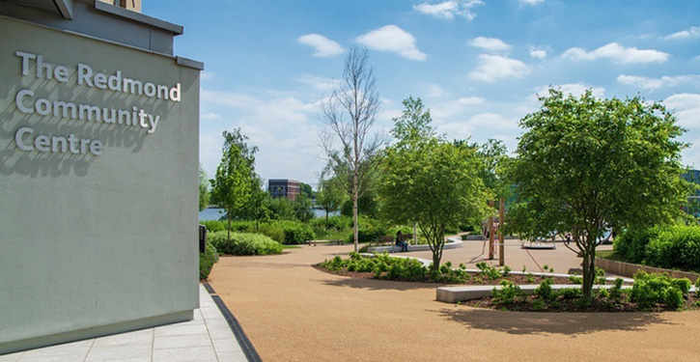
Community Infrastructure
Who Owns Hackney?
Community spaces
Culture
Education
Health
Libraries

Slide 19
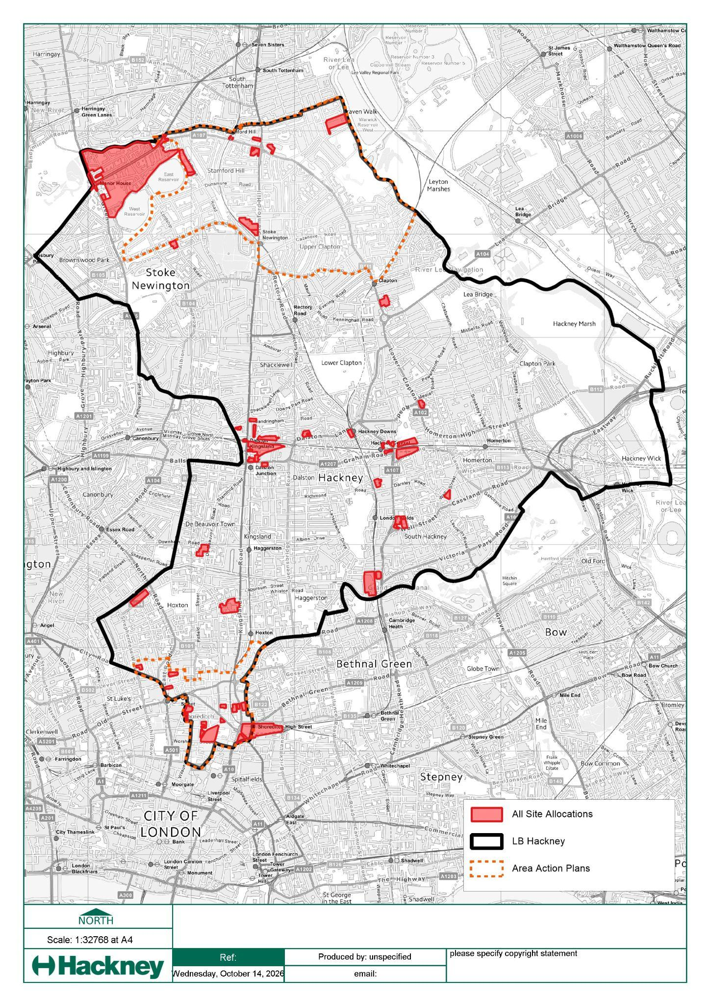
Sites for Development
Use of council-owned land
Finding enough sites
Viability
N
All Site Allocations
LB Hackney boundary
Area Action Plan boundary

Slide 20
Next Steps - Scoping Document
Analysis of response to the scoping end 2 November
Gateway 1 and 30 month timescale
Evidence base briefs - What do we need, and who needs?

Slide 21

Thank You!
Do you have any questions?

