Slide 1
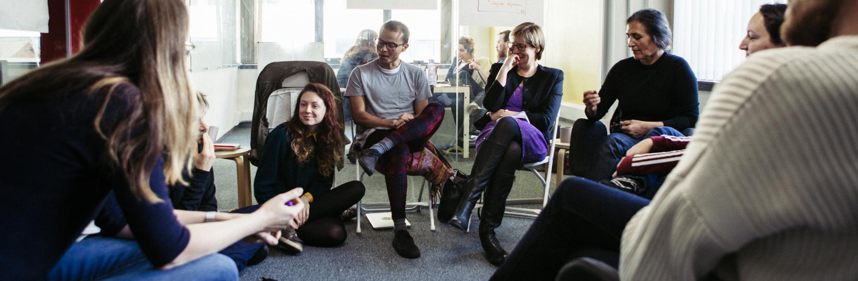
29th November 2024
Outlandish Co-operative
How to Run Inclusive and Effective Meetings
Using Sociocracy to structure discussions and make decisions

Slide 2
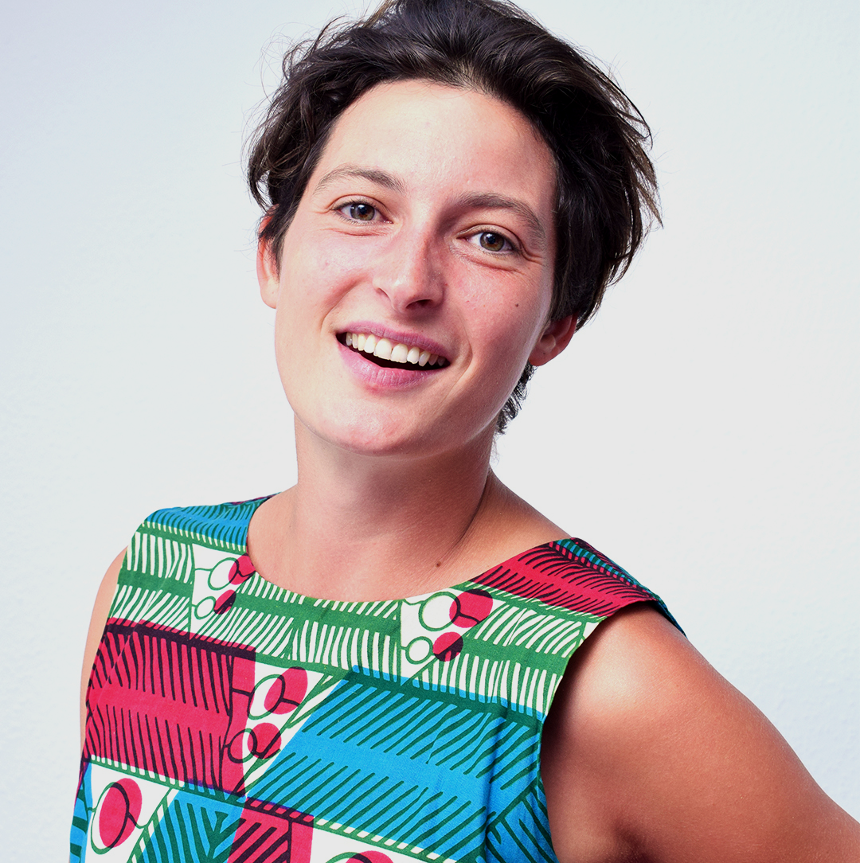
About us
Our Theory of Change:
Outlandish lives and shares a transformative approach to tech business that brings about positive social change, balanced with the importance of a positive working environment.
Polly Robbins
Notes:
Mention trustee stuff

Slide 3
House rules
Check your name/pronouns on Zoom
If you have any immediate questions put your hand up in Zoom
Use chat just for parked questions
Please mute when you’re not speaking
Be mindful of time

Slide 4
About you
(in no more than 2 sentences per round)
1st round: What’s your name + how you’re feeling?
2nd round: What brings you to this workshop?

Slide 5
Aim + Agenda
09:30-10:00
.Introductions.
10:00-10:45
.Practice Rounds and Proposals.
10:45-11:00
.Break.
11:00-11:45
.Practice with a real-life decision.
11:45-12:15
Q&A and intro to implementation.
12:15-12:30
Wrap up.
To give you a chance to learn, practice and reflect on how to use ‘consent-based decision making’, as a way to structure discussions.
We won’t introduce the whole of Sociocracy - but you’ll get a flavour.
To leave this session feeling more confident to use elements of sociocracy in your work.

Slide 6
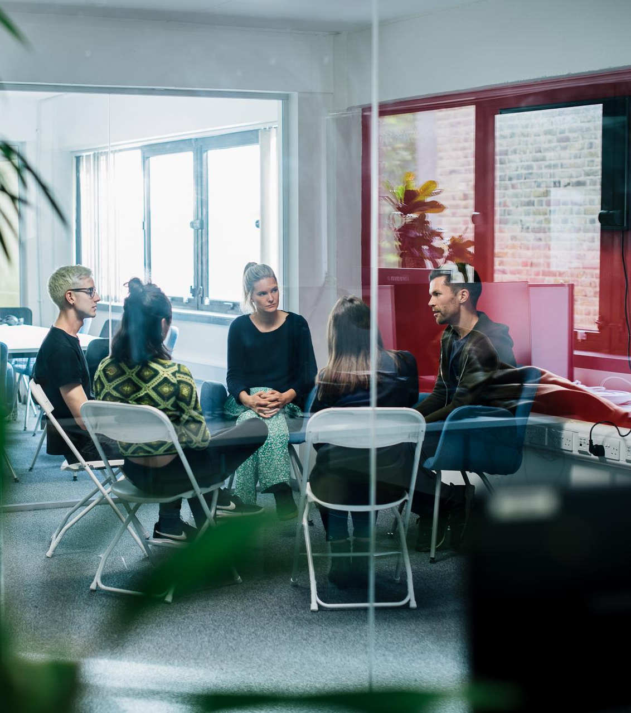
Principles of Sociocracy
Action-focused
Proposals are developed before the meeting
Includes different opinions and voices equally
Aware of context - eg. feelings and power
Active listening
Distributes decision-making and creates a participatory culture
Promotes transparency

Slide 7
Real-life uses in Outlandish
But often, we just use it as a tool to get input from the team, and structure our discussions
Setting pay for members
Extending paternity leave policy
Changing our accountant
Moving to a new office
Seconding staff to another coop
Process
Learning

Slide 8
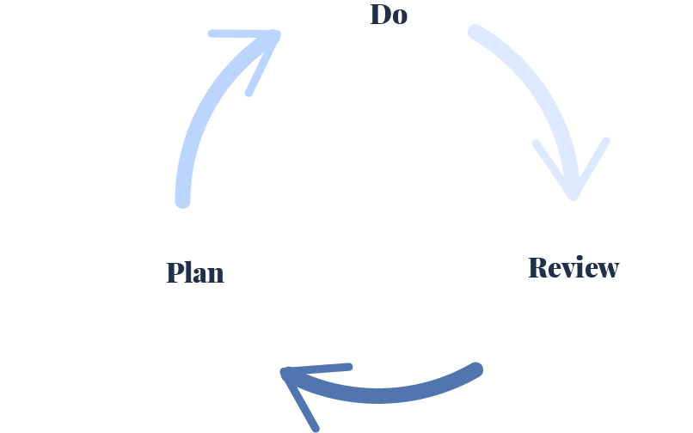
Iterative steps towards goal

Slide 9
Introduction to the Consent Process

Slide 10
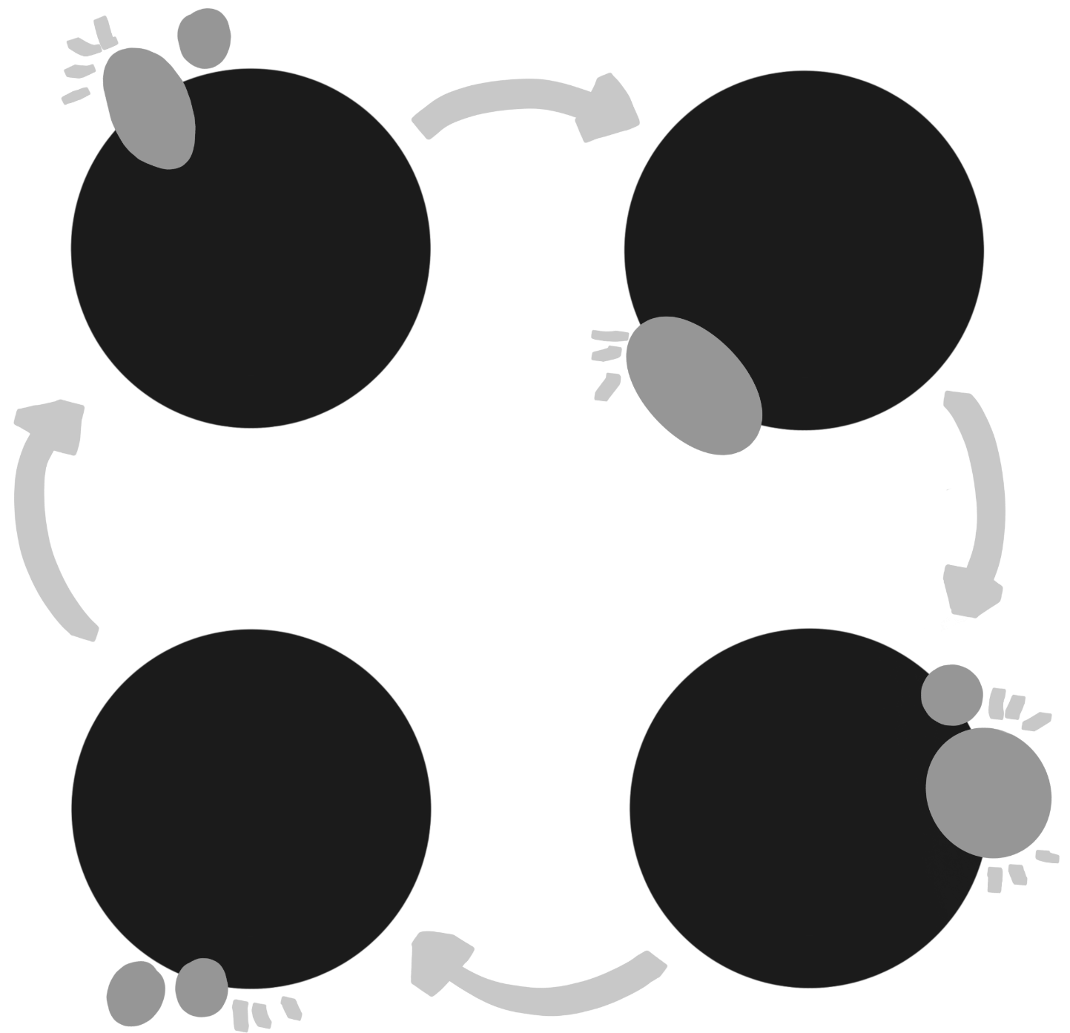
The Sociocratic Process
One person brings a proposal
Everyone has the opportunity to ask non-leading questions
People share how they feel about it
If there are are critical concerns, these can be reintegrated into the proposal to help it pass
PROPOSAL
CLARIFYING QUESTIONS
CRITICAL
CONCERNS
INITIAL REACTIONS

Slide 11
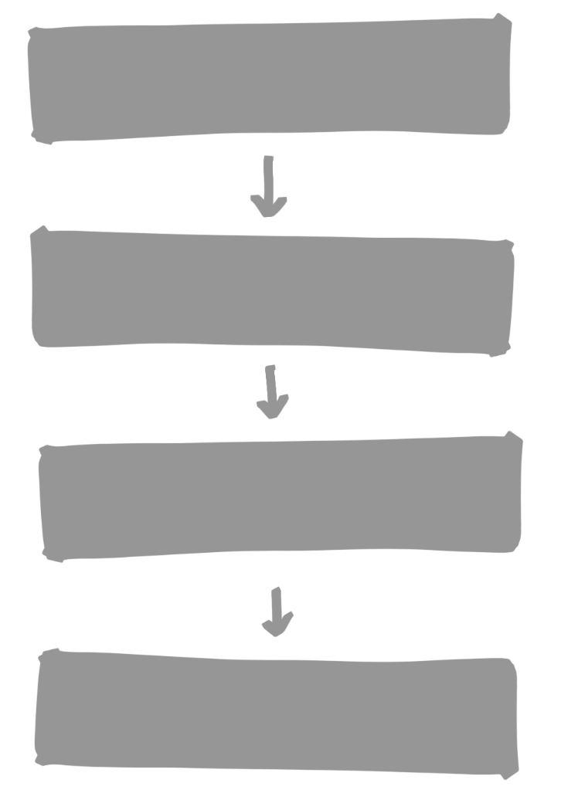

Consent Process
Proposal
Propose
Clarifying questions
Understand
Quick reactions
Explore
Critical concerns
Decide

Slide 12
Consent is acceptance,
not agreement
Good enough
for now,
safe enough
to try

Slide 13

What is ‘Consent’?
“I prefer chocolate”
Preference
“I will eat anything sweet”
Range of tolerance
Objections
“I am allergic to nuts”

Slide 14
Consent Process
Bring a proposal
Appoint a facilitator and a notetaker
Agree time boundary
State the proposal
Clarifying round - Do you have any clarifying questions?
Quick reactions - What’s your initial reaction?
Test for consent - Do you have any critical concerns? Yes/No
Gather concerns
Find solutions
Restate the revised proposal
Repeat from step 5

Slide 15
Test for consent
[yes/no]
Gather and group concerns
Redraft proposal [optional]
Integrate concerns

Slide 16
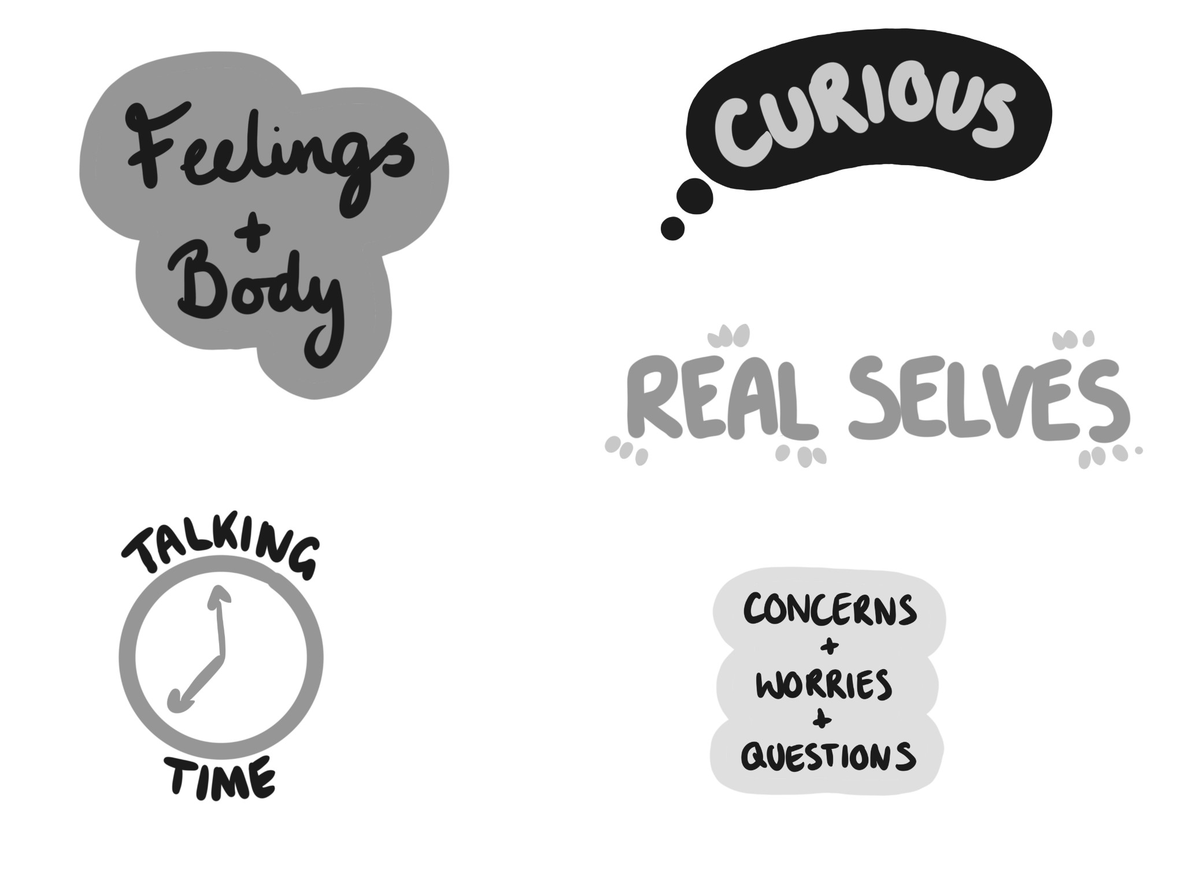



Tips
Bring your real selves to the practise sessions
Notice how much you are talking
Pay attention to your feelings and body. Notice how these might change in different conversations
Raise concerns, worries and questions - be brave!
Be curious

Slide 17
Practice

Slide 18
We turn off all our communication methods (mobile phones, email client and Slack) off until the end of the workshop
We run the rest of this proposal standing up
Everyone has to say “check” when they have finished speaking
We don’t use gendered language to refer to multiple people e.g. guys
All of us give £3 to charity after the session
Something of your choice

Slide 19
Bring the proposal
Appoint a facilitator and a notetaker
Agree time boundary
State your proposal

Slide 20
5. Clarifying round
“Do you have any clarifying questions?”
Your chance to understand the proposal
6. Quick reactions
“What’s your initial reaction?”
How you feel about the proposal in one sentence
7. Test for consent
“Do you have any critical concerns? Yes/No”
Think about your range of tolerance.
Is the proposal good enough for now, safe enough to try?
The Rounds
Notes:
Non-leading questions
Remember that you’re on the same team!

Slide 21
8. Gather concerns
9. Find solutions
10. Restate the revised proposal
11. Repeat from step 5

Slide 22
BREAK!!!

Slide 23
Reflections
What did we learn or discover? What was surprising?
What was satisfying? What was dissatisfying?
Notes:
What did we learn or discover? What was surprising? What was satisfying? What was dissatisfying?

Slide 24
So what makes a good proposal?
Plan it well in advance of the meeting
You can work by yourself or with your team
Write it up and share it before the meeting
Refer to the context
Include a vision and goal
Break it down to make it less complex
Evidence the thought and effort that’s gone into preparing it
Sound people out to gather input and preempt concerns
Think about…
Cost implications
Who will do the work
When the work will be done
The full lifecycle of the proposal
Safe, specific parameters
Notes:
You can also bring proposals that aren’t well thought out - it’s a good structure to discuss things

Slide 25
Example Proposal
Outlandish Speaking + Networking Budget
https://docs.google.com/document/d/1S83J1UzXcToOvaE_xXTJw0OjH2xEFmcsVXtiJQUsXzE/edit#heading=h.4zynlmxwi270
Notes:
You can also bring proposals that aren’t well thought out - it’s a good structure to discuss things

Slide 26
Example Proposal Template
Reason
Description
Timeframe
Timeline
Team
Costs
  External
  Internal
Notes:
You can also bring proposals that aren’t well thought out - it’s a good structure to discuss things

Slide 27
Additional tools for great meetings
Meeting Roles
  The chair should ideally not run the proposals
  Barometer
  Scribe
Good agenda and minutes structure with clear actions and attributions
Additional awareness of power imbalances and how to overcome them
Notes:
You can also bring proposals that aren’t well thought out - it’s a good structure to discuss things

Slide 28
Example Proposal
Outlandish Agenda Template
https://docs.google.com/document/d/1o_CBhPzQYU3lBCHUwUVsUjGQkfXDdaHKcKXxWkrGAi0/edit?tab=t.0
Notes:
You can also bring proposals that aren’t well thought out - it’s a good structure to discuss things

Slide 29
Any Questions before we start again?

Slide 30
Who could allow us to play with one of their real-life scenarios?

Slide 31
Bring the proposal
Appoint a facilitator and a notetaker
Agree time boundary
State your proposal

Slide 32
5. Clarifying round
“Do you have any clarifying questions?”
Your chance to understand the proposal
6. Quick reactions
“What’s your initial reaction?”
How you feel about the proposal in one sentence
7. Test for consent
“Do you have any critical concerns? Yes/No”
Think about your range of tolerance.
Is the proposal good enough for now, safe enough to try?
The Rounds
Notes:
Non-leading questions
Remember that you’re on the same team!

Slide 33
8. Gather concerns
9. Find solutions
10. Restate the revised proposal
11. Repeat from step 5

Slide 34
Reflections
What did we learn or discover? What was surprising?
What was satisfying? What was dissatisfying?
Notes:
What did we learn or discover? What was surprising? What was satisfying? What was dissatisfying?

Slide 35
How can you start using Sociocracy to make your meetings and conversations
more effective?

Slide 36
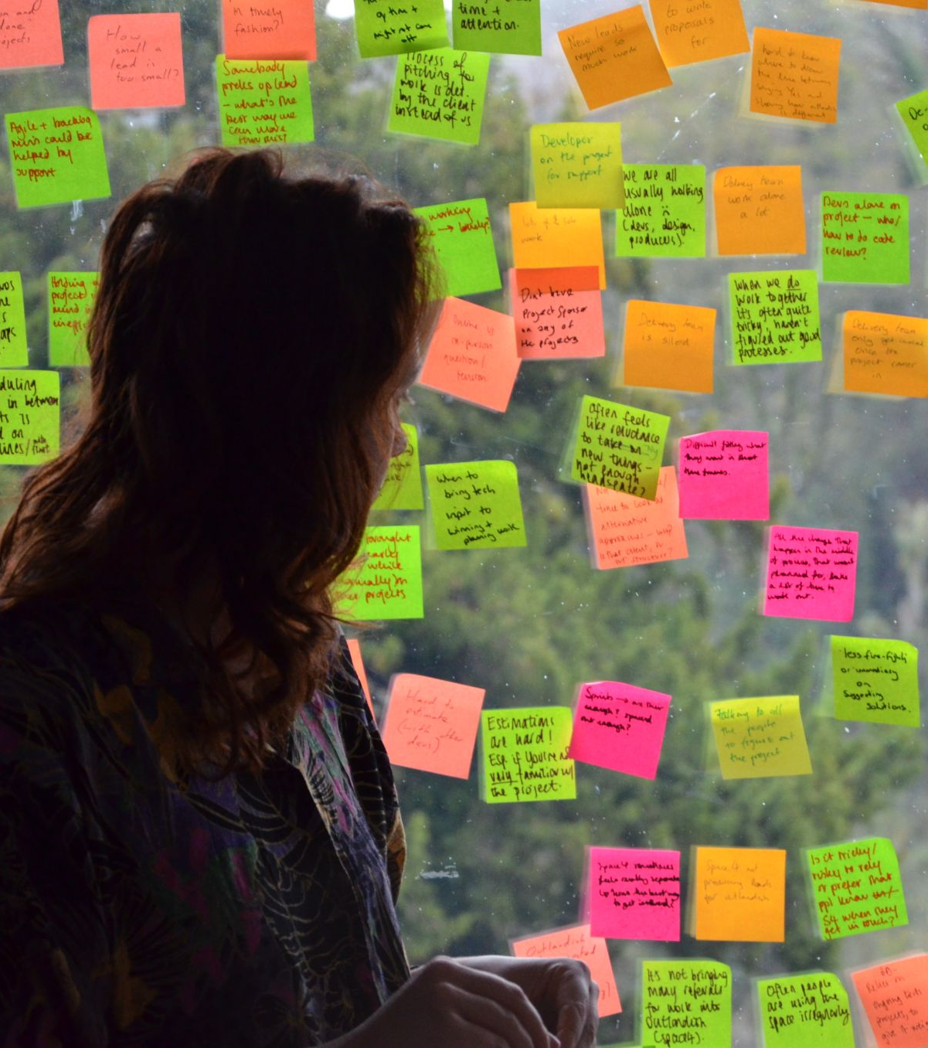
Encourage people to develop proposals before a meeting (but help them!)
Apply Sociocracy to a safe team, small decisions, certain budget range
Stop after the clarifying questions and initial reactions round, or gather concerns but don’t try to integrate them in the meeting
Ensure all minutes have clear actions recorded, and that everyone has consented to taking on these actions
Just try talking in rounds!
Notes:
You can also bring proposals that aren’t well thought out - it’s a good structure to discuss things

Slide 37
More information

Slide 38

Reading
Outlandish on how to write a good sociocratic proposal
Ted Rau on the validity or otherwise of objectives
Strategies for integrating objections from Sociocracy for All
The difference between individual and organisational decision-making by Doug Belshaw
Using consent asynchronously (and some helpful insights into objections) with Loomio

Slide 39


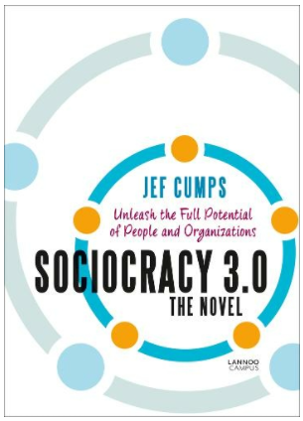

Slide 40

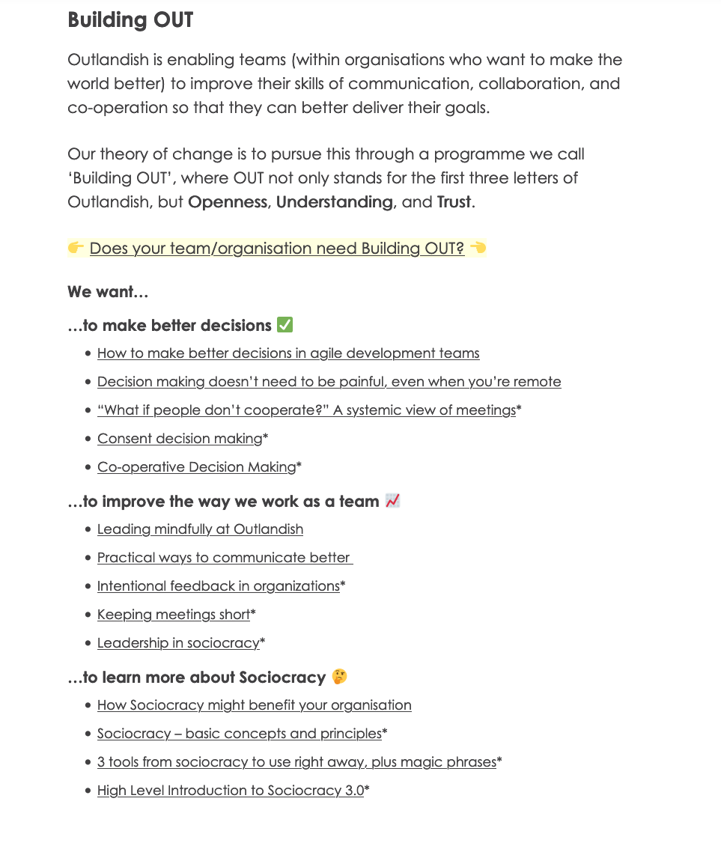
outlandish.com/playbook

Slide 41
Check Out

Slide 42
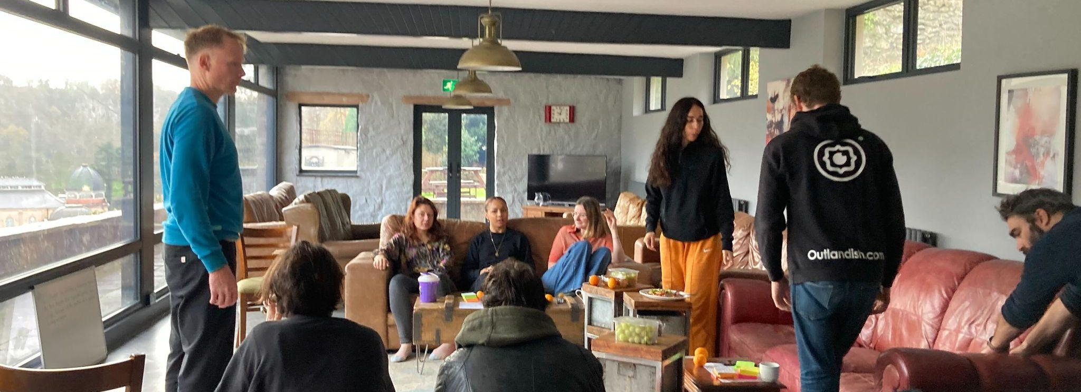
Thank you!
Any questions please email
polly@outlandish.com or natasha@outlandish.com

