Slide 1

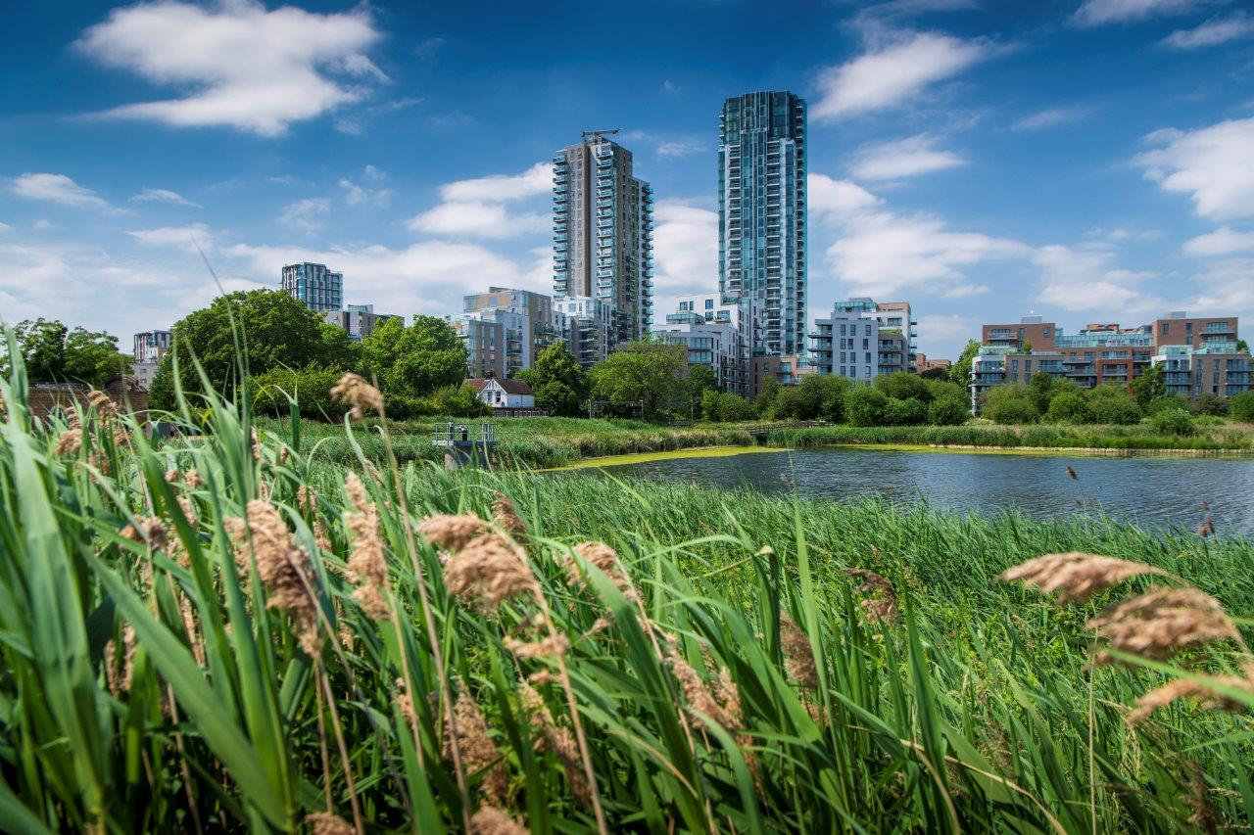



Intermediate Offer – Woodberry Down

Slide 2
Agenda
Welcome and introductions
The context: Principal Development Agreement (PDA)
Intermediate products
Shared Ownership – explained by NHG Sales
Future discussions

Slide 3
Principal Development Agreement (PDA)
PDA definition - “Intermediate Housing Units” means Affordable Shared Ownership Units and Affordable Shared Equity Units
The PDA sets out the NHG purchase prices for Social Rent (SR), Shared Ownership (SO) & Shared Equity (SE) homes
NHG entered into the PDA based on these products and the affordable housing viability

Slide 4
London Living Rent
Initial three year fixed-term tenancy for households earning under £60k with reduced rent to allow residents to save towards buying their home via SO.
    0 conversions to home ownership since 2018
    Finances and/or savings have been squeezed by the cost-of-living crisis, hindering conversions to SO.
  LLR not financially viable
  NHG currently has 42 void homes out of 355 total (12%) due to strict eligibility criteria
  LLR product discontinued in 2023 for new NHG projects

Slide 5

Hackney Living Rent
A new type of affordable housing, aimed at people on middle incomes that wouldn’t normally qualify for social housing.
Rents are calculated based on a third of average ward-level incomes
Lettings policy set up: £60k/annum max household income, 3 year live/work connection to the borough, must not own a home
Subject to minimum household requirements (e.g. couple -> 1 bed)
Successful applicants will go to a randomised ballot
4 market rent homes subsidise 1 living rent home
No option/requirement to buy the property after X years like LLR
Woodberry Down levels 23/24: £1027 - 1 bed, £1141 - 2 bed, £1255 - 3 bed

Slide 6
Intermediate market rent
£60k household income cap
80% market rent
  c.£1,600pcm based on private rent of £2,000pcm for one bed home at Woodberry Down
Affordability check – rent and long-term commitments must not exceed 45% of income
  Income of £43k/pa to pass affordability check at Woodberry Down for a one bed home
    45% of £3,600pcm = £1,620 / 3,600*12 = £43,200
    Must be working and pay by Direct Debit
Advertised on Rightmove with no borough nominations unless dictated by s.106
No new build NHG developments include IMR unless specified in the s.106
NHG offers IMR for refurbished family homes in outer London boroughs through SimplyCity
Initial one-year tenancy. Three-year max. tenancy – designed to allow tenants to save and move on

Slide 7
Shared Equity at Woodberry Down
The three Delivery Partners; Hackney Council, Berkeley Homes & NHG have worked together to develop an accessible option for leaseholders who wish to remain on Woodberry Down.
Existing Woodberry Down leaseholders can purchase a share of one of the new homes from NHG. Any unsold equity gap is retained by NHG, but no rent charged. This is funded by London Borough of Hackney, Berkeley Homes and NHG.

Slide 8
Shared Ownership
A regulated affordable product that is delivered under local planning policy
Financially viable at PDA agreed package prices
Open to most people with a household income of under £90,000 – affordability checks in place to ensure sustainable home ownership
Low rent on unsold equity (e.g. 1.15-2.75% on Phase 3) – significantly less than current mortgage rates.

Slide 9
What is Shared Ownership?
Allows buyers to purchase a percentage (min. 25% on Phase 3) of a property to help them get on the property ladder
Rent is paid on the unsold equity and the leaseholder can increase their share in increments until they own their home outright
The rent is charged on the unsold equity, usually capped at a maximum of 2.75%

Slide 10
Benefits of Shared Ownership
- Allows people to get on the property ladder in relatively expensive and desirable locations.
The combined mortgage and rent is usually cheaper than the cost to purchase on the open market
- The deposit will generally be 5-10% of the price of the share, not of the full market value of the whole property. That means your deposit is less than it usually would be to buy outright.
- With Shared Ownership, you’re an owner-occupier providing long-term security
- You can make your home your own, with more freedom to decorate to reflect your own style and personality versus private renting

Slide 11
One bedroom home at woodberry down
Bed size | Market Value | Share Purchased | Share value (£) | Deposit amount (5.00%) | Monthly mortage payments | Rent | Monthly rent | Monthly service charge | Monthly Cost | Min annual income required
Shared Ownership
1 bedroom | £480,000.00 | 25% | £120,000 | £6,000 | £665 | 2.75% | £825 | £188 | £1,679 | £60,492
1 bedroom | £480,000.00 | 10% | £48,000 | £2,400 | £266 | 2.75% | £990 | £188 | £1,444 | £52,053
Open market rent
1 bedroom | 480,000 | 0% | - | - | - | - | £2000 | - | £2,000 | -
Private sale
1 bedroom | £480,000.00 | 100% | £456,000 | £24,000 | £2,448 | - | - | £188 | £2,636 | £101,333.33
Shared Ownership is £958 cheaper a month than buying privately, the household income is also around £40k a year less
Shared Ownership is £321 a month cheaper than privately renting

Slide 12
TWO bedroom home at woodberry down
Bed size | Market Value | Share Purchased | Share value (£) | Deposit amount (5.00%) | Monthly mortgage payments | Rent | Monthly rent | Monthly service charge | Monthly Cost | Min annual income required
Shared Ownership
2 Bedroom | £635,000 | 25% | £158,750 | £7,938 | £880 | 2.40% | £953 | £331 | £2,163 | £77,961
2 Bedroom | £635,000 | 10% | £63,500 | £3,175 | £352 | 2.40% | £1,143 | £331 | £1,826 | £65,797
Open market rent
2 Bedroom | £635,000 | 0% | - | - | - | - | £2,574 | - | £2,574 | -
Private sale
2 Bedroom | £635,000 | 100% | £603,250 | £31,750 | £3,238 | - | - | £331 | £3,569 | £134,056
25% Shared Ownership is £1,406 cheaper a month than buying privately, the household income is also around £56k a year less
25% Shared Ownership is £411 a month cheaper than privately renting

Slide 13
THREE bedroom home at woodberry down
Bed size | Market Value | Share Purchased | Share value (£) | Deposit amount (5.00%) | Monthly mortgage payments | Rent | Monthly rent | Monthly service charge | Monthly Cost | Min annual income required
Shared Ownership
3 Bedroom | £900,000 | 25% | £225,000 | £11,250 | £1,247 | 1.15% | £647 | £408 | £2,302 | £82,961
3 Bedroom | £900,000 | 10% | £90,000 | £4,500 | £499 | 1.50% | £1,013 | £408 | £1,919 | £69,166
Open market rent
3 Bedroom | £900,000 | 0% | - | - | - | - | £4,000 | - | £4,000 | -
Private sale
3 Bedroom | £900,000 | 100% | £855,000 | £45,000 | £4,590 | - | - | £408 | £4,998 | £190,000
25% Shared Ownership is £2,696 cheaper a month than buying privately, the household income is also around £107k a year less
25% Shared Ownership is £1,698 a month cheaper than privately renting

Slide 14
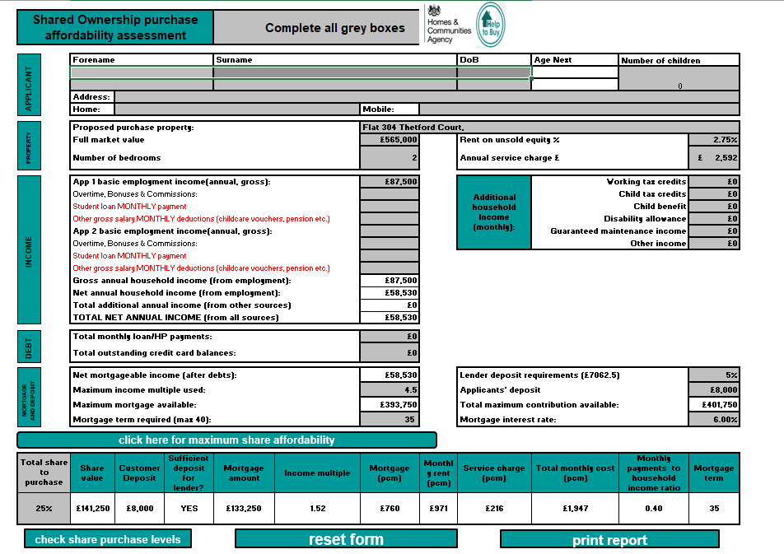
Purchasing a shared ownership home
All buyers are subject to an affordability assessment by our trained external Financial advisors, who review all aspects of their financial lives.
Buyers have to be able to demonstrate they can sustain ownership for a long period of time.

Slide 15
Purchasing a shared ownership home
Below are examples of financial scenarios acceptable to buy Shared ownership at woodberry down
 | One Bed examples
 | Household Income | Deposit | Monthly cost | Share purchasing
Buyer 1 | £39,798 | £104,400 | £1,104 | 25%
Buyer 2 | £44,593 | £81,600 | £1,237 | 25%
Buyer 3 | £49,893 | £56,400 | £1,385 | 25%
Buyer 4 | £55,192 | £31,200 | £1,532 | 25%
 | Two Bed examples
 | Household Income | Deposit | Monthly cost | Share purchasing
Buyer 1 | £47,915 | £150,813 | £1,330 | 25%
Buyer 2 | £52,589 | £128,588 | £1,459 | 25%
Buyer 3 | £58,598 | £100,013 | £1,626 | 25%
Buyer 4 | £62,938 | £79,375 | £1,747 | 25%
 | Three Bed examples
 | Household Income | Deposit | Monthly cost | Share purchasing
Buyer 1 | £39,798 | £104,400 | £1,104 | 25%
Buyer 2 | £44,593 | £81,600 | £1,237 | 25%
Buyer 3 | £49,893 | £56,400 | £1,385 | 25%
Buyer 4 | £55,192 | £31,200 | £1,532 | 25%
All data based on £480k for a one bed, £635k for a two bed and £900k for a three bed and interest rates at 5.75%

Slide 16
RESALE and staircasing
You can staircase at any time, partially or to complete 100% ownership
The staircasing process involves getting a RICs valuation on your home, instruct and pay fees and organise the finance for the amount of your home you want to purchase.
In the event a customer owns more than 25% and needs to reverse staircase that can be arranged on a case-by-case basis.
When a resident decides they want to sell the only restriction is we for 8 weeks try to sell their share of the home rather than 100% of the property, to retain the affordable housing long term.
NHG Sales facilitated 302 Resales transactions in 21/22
386 Staircasing transactions carried out in 21/22

Slide 17
Our SO BUYERS AT WOODBERRY DOWN
Sales Leads Income Ranges
29
Shared Ownership Lenders
Sales Rate (per month)
Mortgage Lenders
Share purchase %
Household Income Ranges
8
Leaseholders
Staircasing
Bed size | Average Share | Count
1 bed | 39% | 71
2 bed | 36% | 51
All beds | 38% | 122
Bed size | Range | Average
1 bed | £43k - £85k | £57k
2 bed | £60k - £90k | £74k
Min 10% increments

Slide 18
Phase 2 - Shared Ownership Occupations
Occupation | Count
Accountancy, Banking & Finance | 8
Teaching & Education | 7
Property, Real Estate & Construction | 6
Information Technology | 6
Arts & Entertainment | 5
Marketing, Advertising & PR | 4
Retail & Sales | 4
Healthcare & Medicine | 3
Charity & Voluntary | 2
Law (legal) | 2
Science & Technology | 2
Business, Consulting & Management | 1
Hospitality & Events | 1
Leisure, Sport & Tourism | 1
Transport & Logistics | 1

Slide 19



Buyer specific data at Woodberry Down
Buyers Living In
Buyers Working In
Buyers Age Range

Slide 20
Shared Ownership – Hackney context
The Council will only consider 4 tenures in its own schemes: Outright sale, Shared Ownership, Social Rent and Hackney Living Rent.
Intermediate products that enable people to step into homeownership in high-cost areas like Hackney are an important and should continue to be offered.
The Council doesn’t run any key worker schemes, as this is too difficult to accurately define, instead choose to define by income bandings as key workers often fall into these.
Hackney is working on the new Housing Strategy to address the issues raised in recently commissioned research and will deliver this in 2024.
67% of stakeholders surveyed agreed/strongly agreed that Hackney needs more low-cost housing options such as shared ownership.
Hackney Sales has a waiting list of people looking for shared ownership, an in-demand product.

Slide 21
Shared Ownership conclusion
Helps Londoners get on the property ladder (expensive open market values).
More appealing in the current climate - Rent on the unsold equity is capped at 2.75% for the first year, whereas a mortgage rate % can continue to increase with the BoE.
More than 202,000 shared ownership homes in the UK.
More accessible product than private sale homes.
Government backed, regulated scheme with a continuous pipeline of homes delivered.
Notting Hill Housing was the first housing association to offer SO in 1980 – NHG has decades of experience.

Slide 22
SHARED OWNERSHIP changes for Phase 4 onwards
From Phase 4 the new Shared Ownership lease will be active, major changes are afoot to improve the product for our customers
Minimum stake reduced – Under the new model lease, buyers need only buy 10% of the full market value of the property. The earlier model lease required buyers to buy at least 25%.
Greater flexibility in staircasing – The new scheme has been amended to reduce the minimum initial percentage share to 10% (down from 25%), as well as gradual staircasing in 1% increments. This means shared owners can purchase more shares in smaller instalments than the 10% under the previous model – up to 100% property ownership (subject to any restrictions under the specific lease).
Lengthening of lease term – The length of the new model lease is 990 years – substantially lower than the 125-year lease term under the earlier model. This could well make shared ownership leases under previous models less attractive to future buyers and lenders.
New period for repairing obligations - Shared owners under the new model lease will have the benefit of a new 10-year repair warranty under which the landlords/housing associations are required to pay for essential repairs, up to an annual limit of £500 (any unused element can be carried over to the next year). Beyond that, the shared owner must pay the remainder. Under the earlier model lease, it was the shared owner’s responsibility to foot the entire bill.
Alienation, pre-emption and underletting – Under the new model, the housing association/landlord has an exclusive right to market the property for four weeks only, rather than eight weeks under the earlier model. The valuation validity period has also been extended to 12 weeks prior to the date of exchange (this was previously 8 weeks).

Slide 23
Future Intermediate Discussions 2024-25
No changes to the intermediate offer for Phases 3 & 4
Hackney’s future plans:
  Hackney are in the process of setting up and Intermediate Housing Panel. This panel will investigate and map the need for intermediate housing in the borough and is to be jointly commissioned across Hackney, Islington and Camden. It was approved by Hackney’s internal PSG group consisting of members and will report directly to them.
  The primary purpose of the Panel is to explore the potential role for intermediate housing in Hackney, Camden and Islington. All three councils have an excellent and widely recognised track record of delivery of new housing through their respective programmes over the last ten years. It will focus on the full range of intermediate housing options and assess and make recommendations based on housing need and economic conditions.
  Currently in the process of appointing an independent Chair, following on from that an independent panel will be set up to review existing evidence, compare programmes and review available options as part of their analysis. Focus groups will also be set up to ensure that resident voices are heard.

