Slide 1
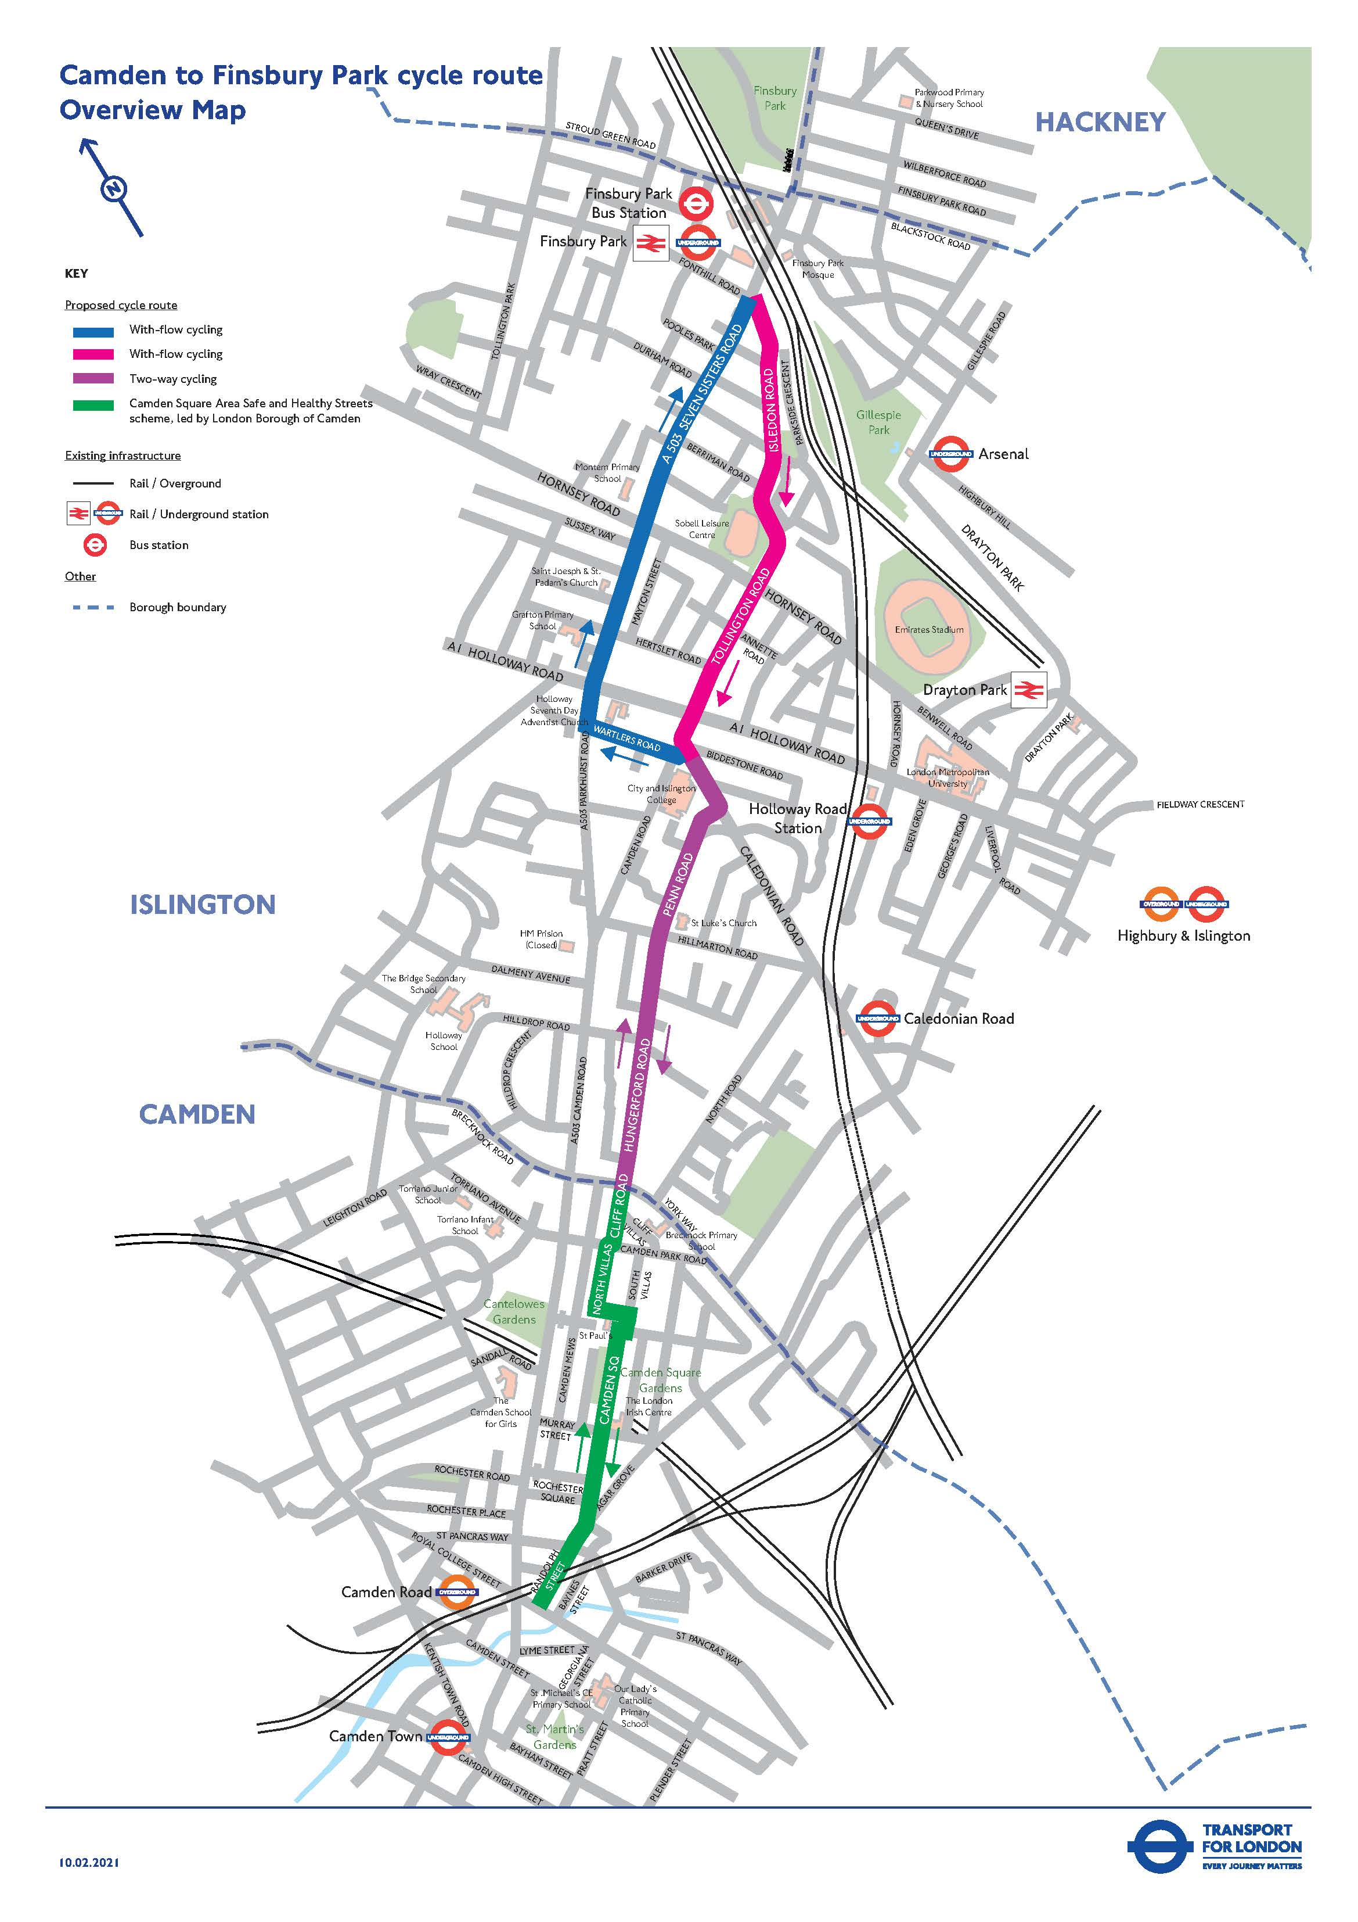

Cycleway 50 – Camden to Tottenham Hale
Phase 1: Camden to Hungerford Rd
Phase 2: Hungerford to Nags Head
Phase 3: Nags Head Gyratory
Phase 4: Finsbury Park to Amhurst
Phase 5: Amhurst to Tottenham Hale

Slide 2
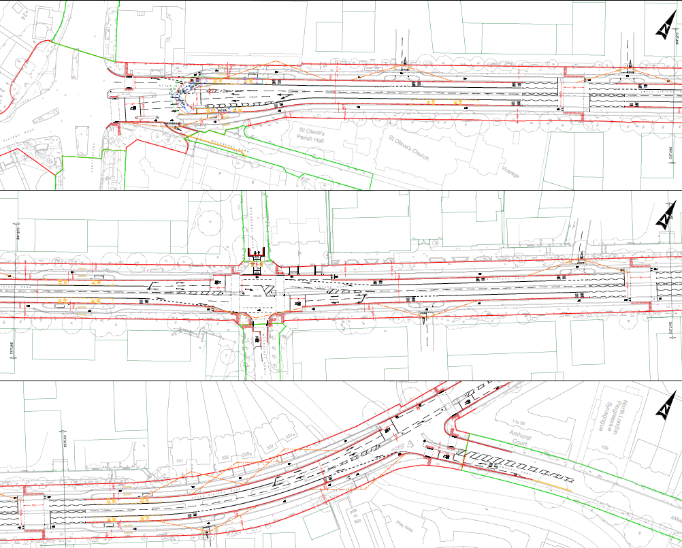
Cycleway 50 – Manor House to Amhurst park (The Woodberry Down section)
Number of scenarios tested:
With flow tracks
Bi-directional track North
Bi-directional track South
Constraint is Manor House Junction:
96% capacity (low resilience)
Large volume right turn into Green Lanes
Bus Turn-around
Cycle facility

Slide 3
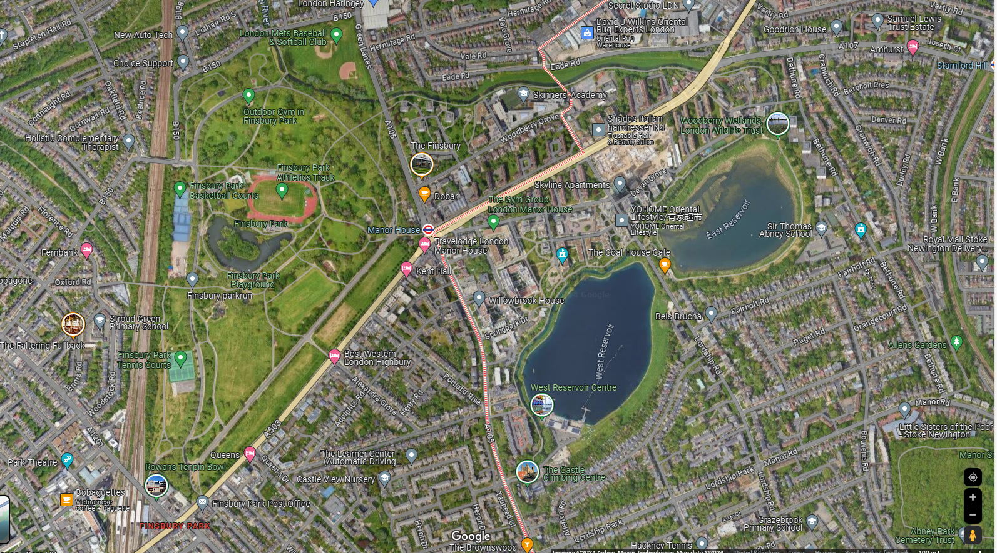
existing footway in the Park.
Cycleway 50 – Finsbury Park to Amhurst
Two-Way cycling on Woodberry Grove
Bi-directional Track on the North side of Seven Sisters Road Between Woodberry Grove and Amhurst Park
New crossing and new entrance into Finsbury Park connecting with the existing park road
Bi-directional cycling through Finsbury Park with connection to C50 at Finsbury Park Station Junction

Slide 4
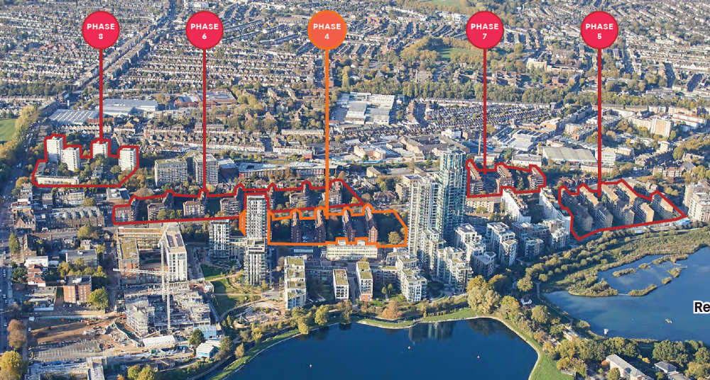
C50 Woodberry Down
Public realm strategy, updated Feb 2025

Slide 5
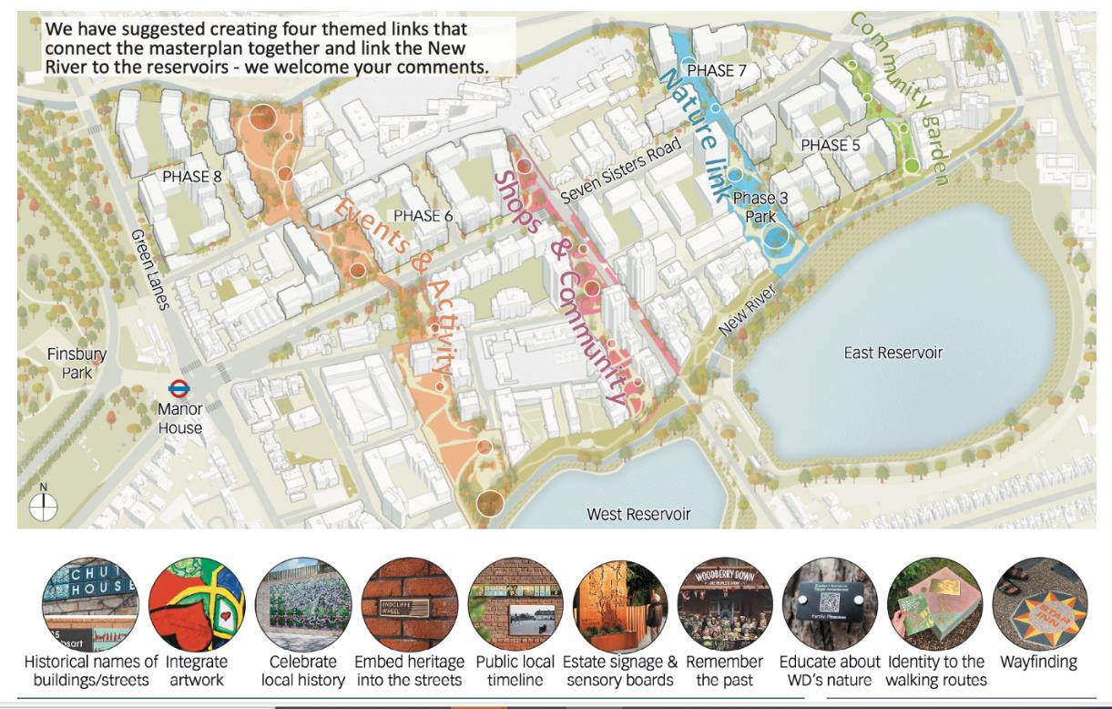
Public Realm Strategy
for Seven Sisters Road
“Woodberry Down will be an open, welcoming place where people choose to live, feel safe, are in touch with the natural environment, benefit from a range of facilities for the community and have a strong sense of pride”
1. Support the development vision for Woodberry Down
Facilitate the masterplan and cultural strategy
Break down severance
Green Avenue – coherent identity
Linking green infrastructure across Seven Sisters Road, enhance biodiversity
Accessing public transport

Slide 6
TfL Public Realm Strategy
for Seven Sisters Road
2. Support ground floor uses and break down severance
Generous pedestrian space where green links and activity zones in the masterplan meet the street – places to stop, rest or play... Supporting active frontages and building entrances
Crossings on desire lines
Central square

Slide 7
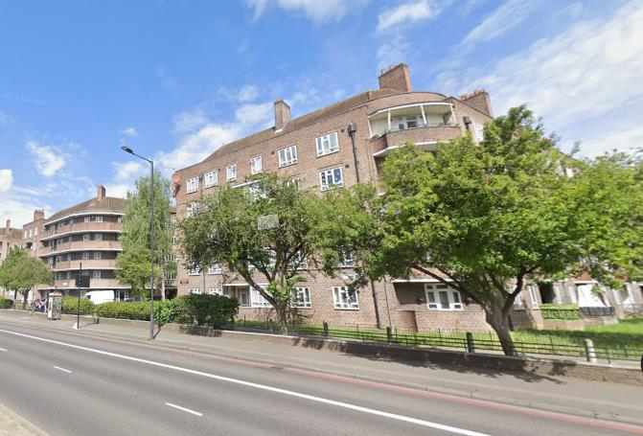
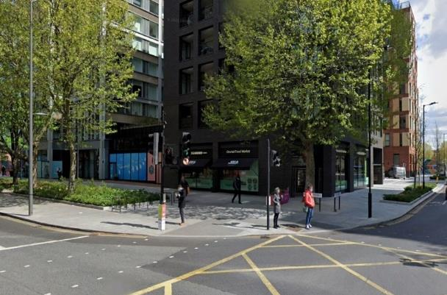
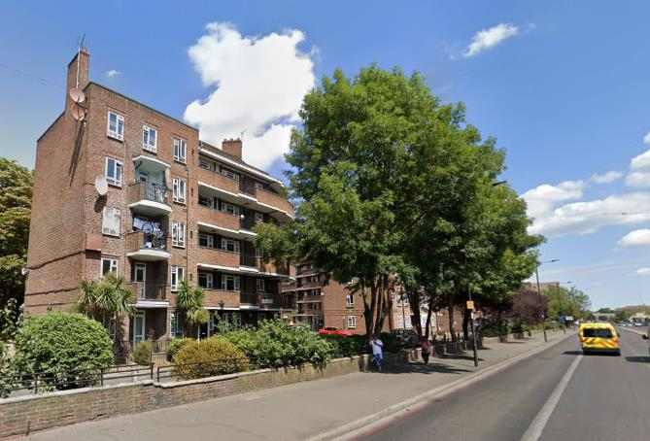
TfL Public Realm Strategy
for Seven Sisters Road
3. Creating a greener, more generously tree-lined street
a) Improve the growing environment for existing mature trees, eg under-planting, joining tree pits
Walworth Road

Slide 8
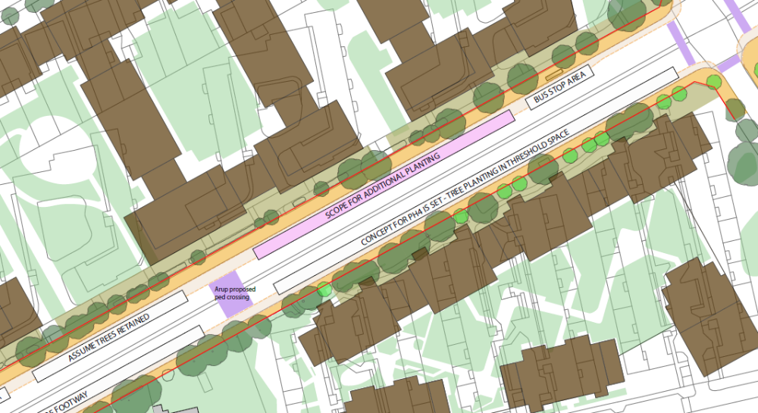
TfL Public Realm Strategy
for Seven Sisters Road
3. Creating a greener, more generously tree-lined street
b) Taking opportunities to introduce new tree planting
Mostly adjacent to future development phases
Working with developers to find best locations for new trees (private land / highway land)
Using the tree line to help delineate cycle track
Phase 6
Opportunity to work together to expand tree canopy cover
Phase 4

Slide 9
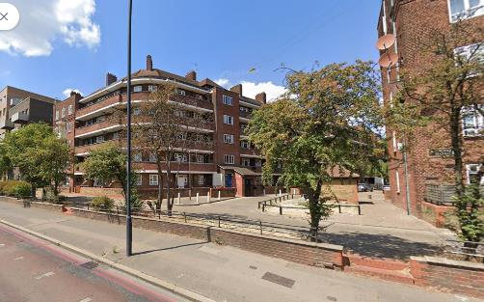
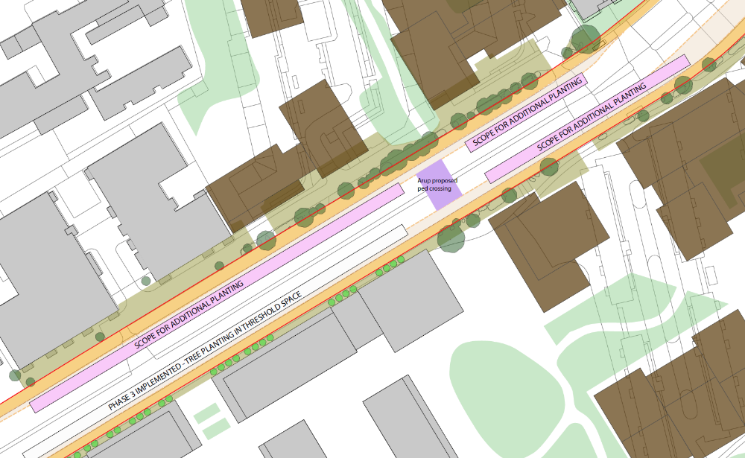
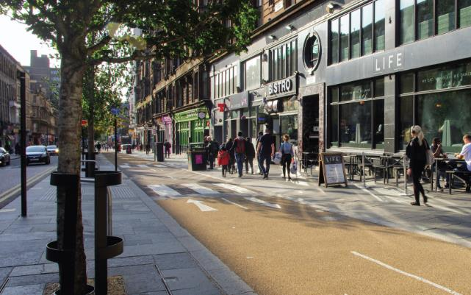
TfL Public Realm Strategy
for Seven Sisters Road
3. Creating a greener, more generously tree-lined street
Significant planting opportunities east of Woodberry Grove, where access roads have been removed
Phase 7
Integrating a two-way cycle track with a median/verge that includes tree planting
Phase 5
Sauchiehall Street, Glasgow

Slide 10
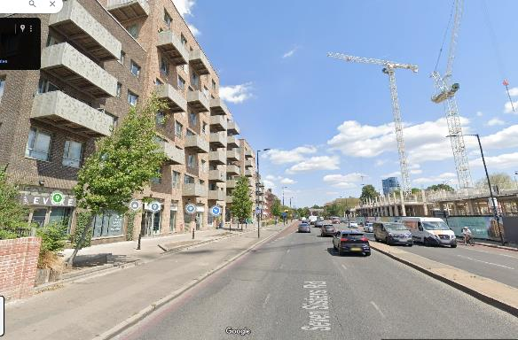
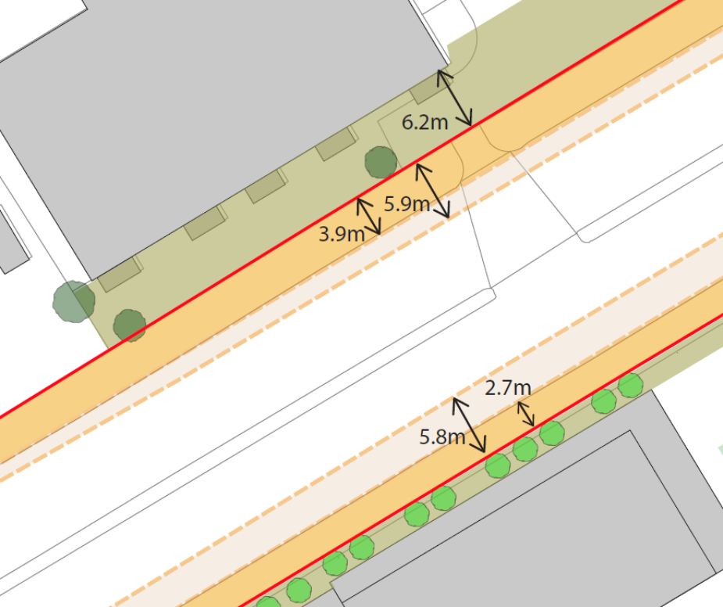
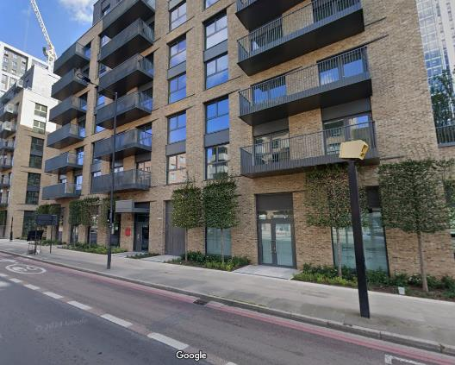
TfL Public Realm Strategy
for Seven Sisters Road
Opportunities to revisit threshold planting at Kick-Start Sites?
3. Creating a greener, more generously tree-lined street
Working with phases that have been implemented or consented – layout is to have trees in the threshold space between building and footway
In some locations, footways may be wide enough to incorporate more tree planting at kerbside
Where footways are narrower, a second line of trees may be possible if the kerbs is built out (though underground constraints likely to limit this approach)

Slide 11
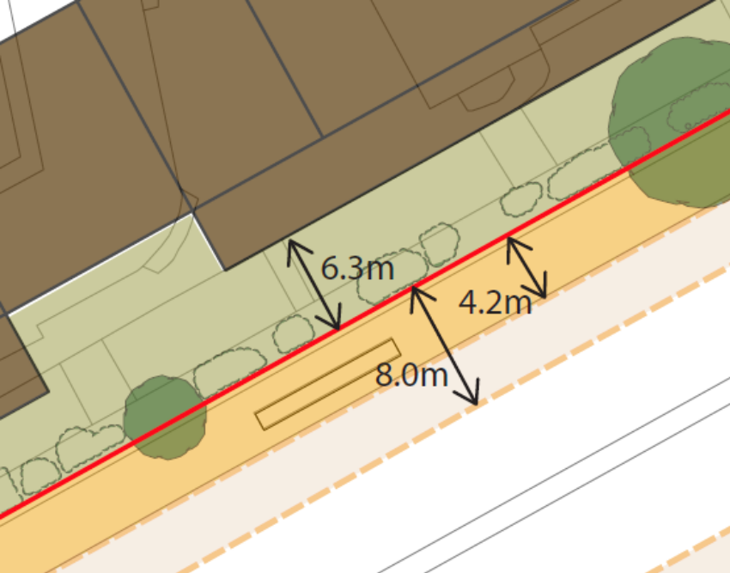
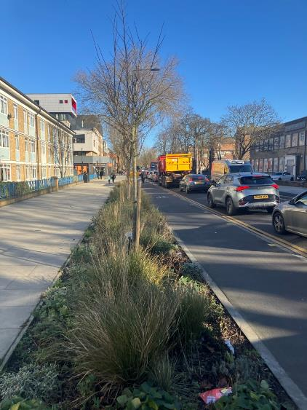
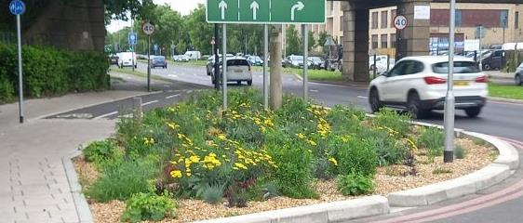
TfL Public Realm Strategy
for Seven Sisters Road
4. Take opportunities to introduce sustainable drainage
Potential for raingardens – more likely to be possible on existing footway space
Raingardens possible at kerbside where there is wide existing footway or where development threshold could be opened up to give generous space for pedestrian movement
If highway design allows for kerb build-out, could explore SuDS on that expanded space but it is likely that underground conditions would not allow it
Romford Road, Newham
Raingarden, Tolworth, Kingston

Slide 12
Summary
Prove the feasibility of using Finsbury Park – June 2025
Highway design Woodbury Grove to Amhurst Park – June 2025
Developed the Urban Design principles ahead of new route feasibility
Post June 2025 – Integrate highway & Urban Design
Romford Road, Newham

