Slide 1
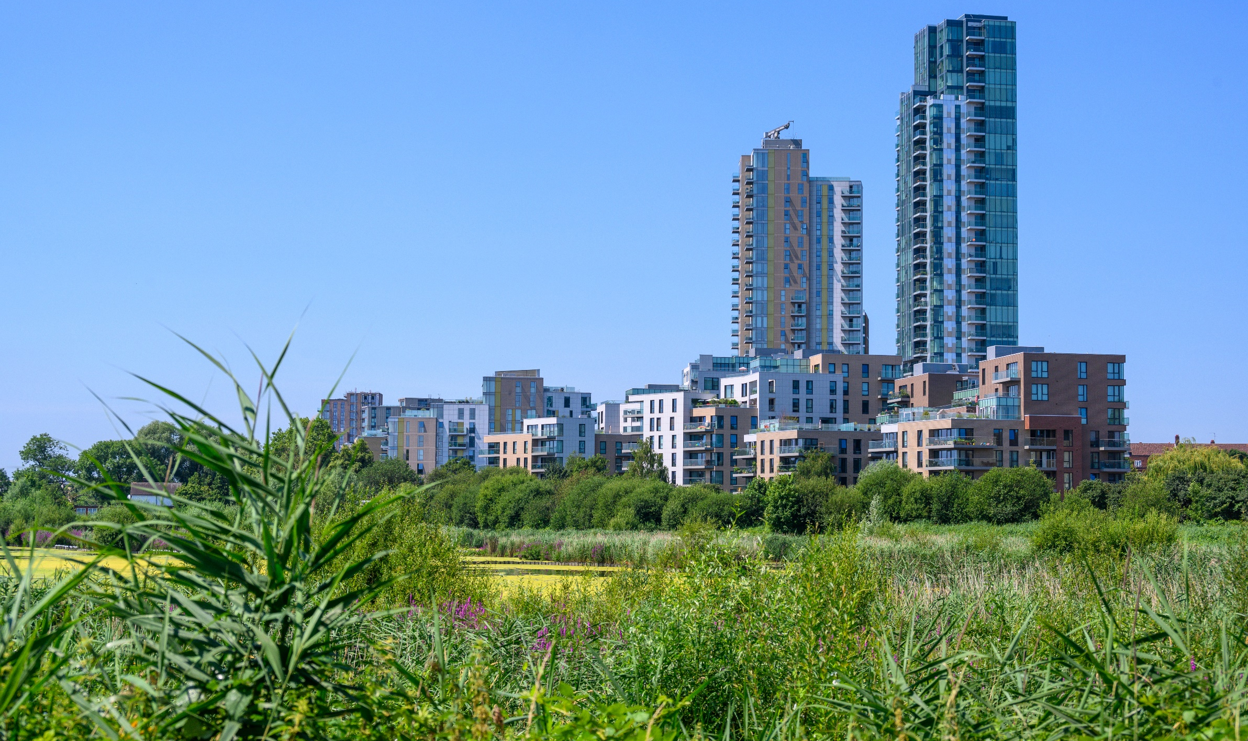







Woodberry Down
WDCO Board Meeting
October 2025

Slide 2

Berkeley Homes (North East London) Ltd
CONTENTS
HEALTH & SAFETY
BUILD PROGRESS
PROGRESS OF HOMES DELIVERED TO DATE
FUTURE PLANNING UPDATE
5. APPRENTICES & LOCAL LABOUR
6. SALES AND MARKETING
7. COMMUNITY ENGAGEMENT
2

Slide 3
Berkeley Homes (North East London) Ltd
HEALTH & SAFETY
There have been no incidents or injuries on the live Construction Site since the last WDCO Board Meeting.
BUILD PROGRESS
Phase 3
Phase 3 will be practically complete by the end of October
The Phase 3 project office will remain in operation throughout the construction of Phase 4, with the potential for continued use during Phase 5
Phase 4
Decision Notice issued on 18th July 2024
Vacant Possession achieved 11th September 2025
Demolition due to commence December 2025
Permanent works due to commence Summer 2026
3

Slide 4
Berkeley Homes (North East London) Ltd
3. PROGRESS OF HOMES DELIVERED (including 268 Green Lanes)
 | Market | Social Rented | Intermediate | Total
Homes Completed | 1771 | 654 | 476 | 2901
Homes in Build (P4) | 289 | 90 | 132 | 511
Homes Permitted | 1762 | 567 | 754 | 3083
Total | 3,822 | 1,311 | 1,362 | 6,495
4

Slide 5
Berkeley Homes (North East London) Ltd
4. FUTURE PLANNING UPDATE
Masterplan
The Masterplan received a resolution to grant at Planning Committee on the 3rd September.
Phase 5
Design Committee workshops will commence shortly and the outcomes of these meetings will be periodically reported back to WDCO Board by the BH Team.
5

Slide 6
Berkeley Homes (North East London) Ltd
5. APPRENTICES & LOCAL LABOUR
We have 5no Apprentices and Graduates working on our Woodberry Down Project.
These are broken down as follows:
  Reach Apprentices (Berkeley Homes direct) - 2
  Berkeley Homes Graduates - 3
  Supply Chain Contractor Apprentices - 0
The local labour levels for September 2025 were:
  23.5% which equates to 9 persons out of 38.2 operatives.
6

Slide 7
Berkeley Homes (North East London) Ltd
6. SALES & MARKETING
Phase 3
49 of 49 sold in Emerald Quarter (Sold Out)
66 of 66 sold in Hawker House (Sold Out)
68 of 68 sold in Darter Apartments (Sold Out)
48 of 50 sold in Amber Apartments
78 of 108 sold in Emperor Point
7

Slide 8
Berkeley Homes (North East London) Ltd
8. COMMUNITY
MHDT will lead delivering the local events, with creative inputs from the other Partners (WDCO, BH, LBH, & NHG).
The remaining event for 2025 is Winterfest (27th November 2025).
The programme of events for 2026 will be discussed by Partners in the New Year.
8

