Slide 1




BERKELEY APPRENTICESHIP
Stav Aristokle Hill
Senior Emerging Talent Manager

Slide 2
BERKELEY APPRENTICESHIP
Ageing Workforce
Skills gaps
Labour needs –50,000 new entrants each year needed*
Support our supply chain
Pave the way for / set the standard
CITB estimates that apprenticeship starts will need to double to meet current recruitment requirements.
*Build UK – ‘Recruiting the next generation 2024’

Slide 3
BERKELEY APPRENTICESHIP
We have had a commitment in place and targets for apprenticeships since 2014
Our Vision 2030 sets out our targets under the priority area of Future Skills:
  Retain membership of The 5% Club
  Target at least 5% of our employees to be in earn and learn roles
These are defined as graduates, apprentices and sponsored students (undertaking a recognised external training course for a duration of several months or more, paid for by the company)
Work with our supply chain to encourage at least 5% of the supply chain working on our sites to be in earn and learn roles
Engage with young people through a range of events from school visits, construction visits, careers fairs and work experience to change the image of the industry and inspire people to join

Slide 4



WHY CHOOSE US?
We’re proud that our inclusive approach to recruitment was recognised with two awards last year: the ‘Apprenticeship Initiative of the Year’ at the London Build Expo’s London Construction Awards 2024 and ‘Candidate Assessment’ award at the In-house Recruitment Awards 2024.​
Berkeley Group has also been named ‘Britain’s Most Admired Company 2024’. We achieved the highest overall scores among 238 companies, coming top in key areas such as ‘Clarity of Strategy’, ‘Long-term Value Potential’, and ‘Reducing Environmental Impact’.

Slide 5
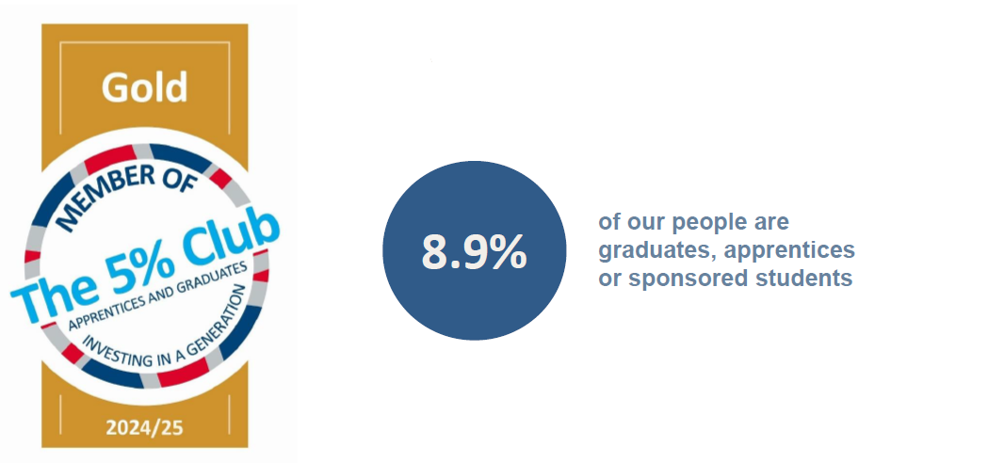
BERKELEY APPRENTICESHIP
We are a Gold member of The 5% Club. This means we achieve at least 5% of our employees in apprenticeship, graduate or ‘earn as you learn’ roles and participate in the Club’s annual audit of data.

Slide 6

BERKELEY APPRENTICESHIP
Berkeley Homes Capital has been awarded - We invest in apprentices and gold accreditation.
In late 2018, Investors in People was commissioned by the Department for Education to create a framework for organisations in the UK to use to ensure they are consistently delivering high-quality apprenticeships.
This accreditation shows that we are committed to our apprentices, we’re developing them for the benefit of the individual and our organisation, and there are clear channels of communication and support for each apprentice.
95% of our apprentices would recommend us to friends and family to undertake an apprenticeship.

Slide 7
WOODBERRY DOWN APPRENTICES PHASE 3

Slide 8
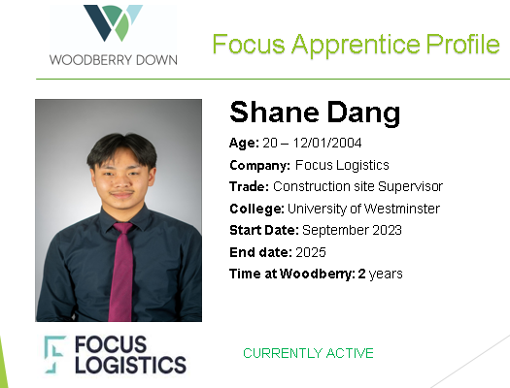
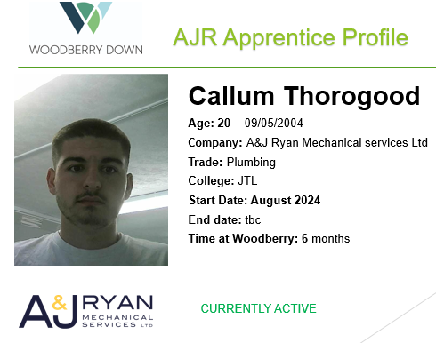
WOODBERRY DOWN APPRENTICES

Slide 9

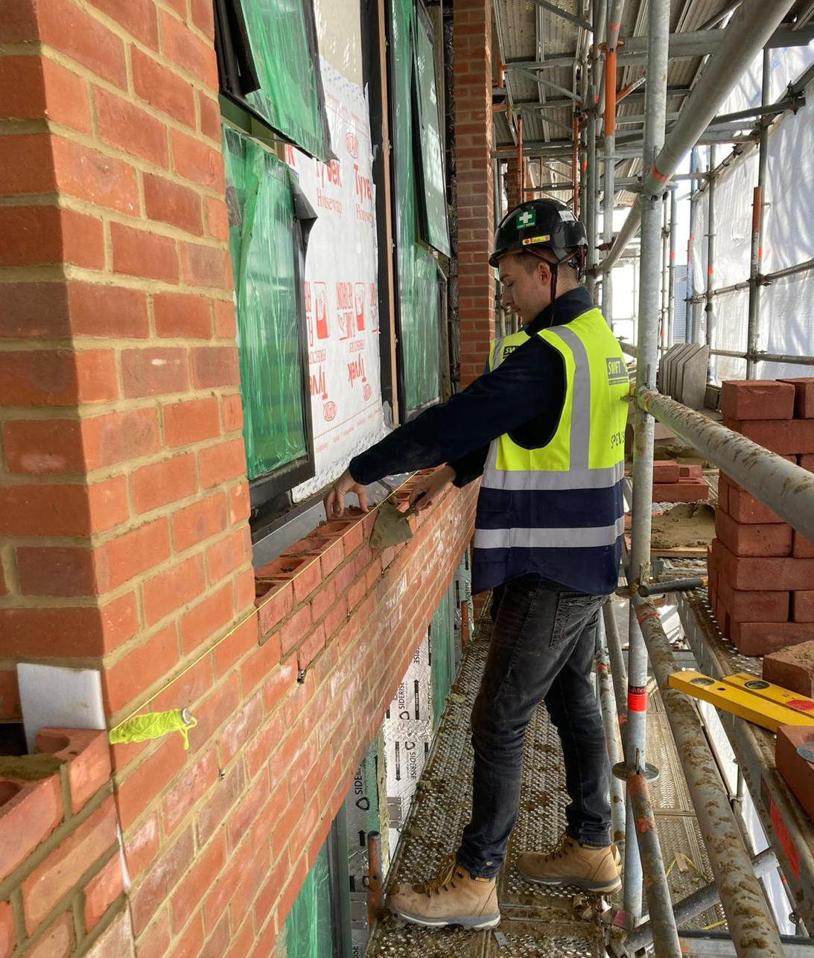
WOODBERRY DOWN CURRENT AND PAST APPRENTICES
Current
Larisa Frangulea
Undertaking level 4 Construction Site Supervisor apprentices 1st year
Past
Jack Kay
Complete his Bricklaying apprenticeship with Berkeley Homes

Slide 10
BERKELY APPRENTICES LIVE
Berkeley Group Programmes:
Site Management (Construction) - Level 3 or 4
Technical (Design) - Level 4
Commercial (Quantity Surveying) - Level 4
Business - Finance /Procurement /Customer Service - Level 3 or 4
To be eligible candidates will need a qualification at level 2 or above and be able to demonstrate new learning and not be overqualified.

Slide 11
BERKELY APPRENTICESHIP ROLES SEPTEMBER 2025
Construction (12 roles):
• Central London
• East London
• South London
• West London
Technical (3 roles):
• Leatherhead
• West London
• Taplow
Commercial (7 roles):
• Leatherhead
• Bath
• Central London
• East London
• West London
Business (3 roles):
• Central London
• Taplow

Slide 12
APPRENTICE CANDIDATE JOURNEY
1. Online Application Form
2. Anonymised Eligibility Check
3. Thrivemap Assessment
Not having a CV reduces bias and allows focus on competency and skills.
Application forms are used at final interview creating consistency for all candidates.
6. Final Interview
5. Assessment Centre -
Skills Based
4. Briefing Call

Slide 13
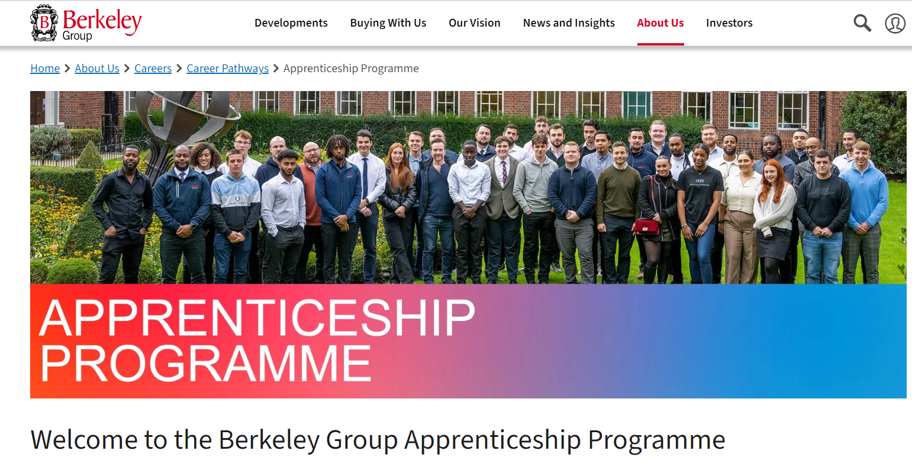



HOW TO APPLY
Apply before 28 March 2025 for the chance to join our Technical, Commercial, Construction and Business teams.
Find out more and apply at
www.berkeleygroup.co.uk/apprenticeships

Slide 14

THANK YOU
Questions
Thank You

